Slide 1
IMDB MOVIE ANALYSIS
FINAL PROJECT - 1

Slide 2
ACTIVITIES INVOLVED
Description
Approach
Problem Statement
Tech-Stack Used
Insights
Results

Slide 3
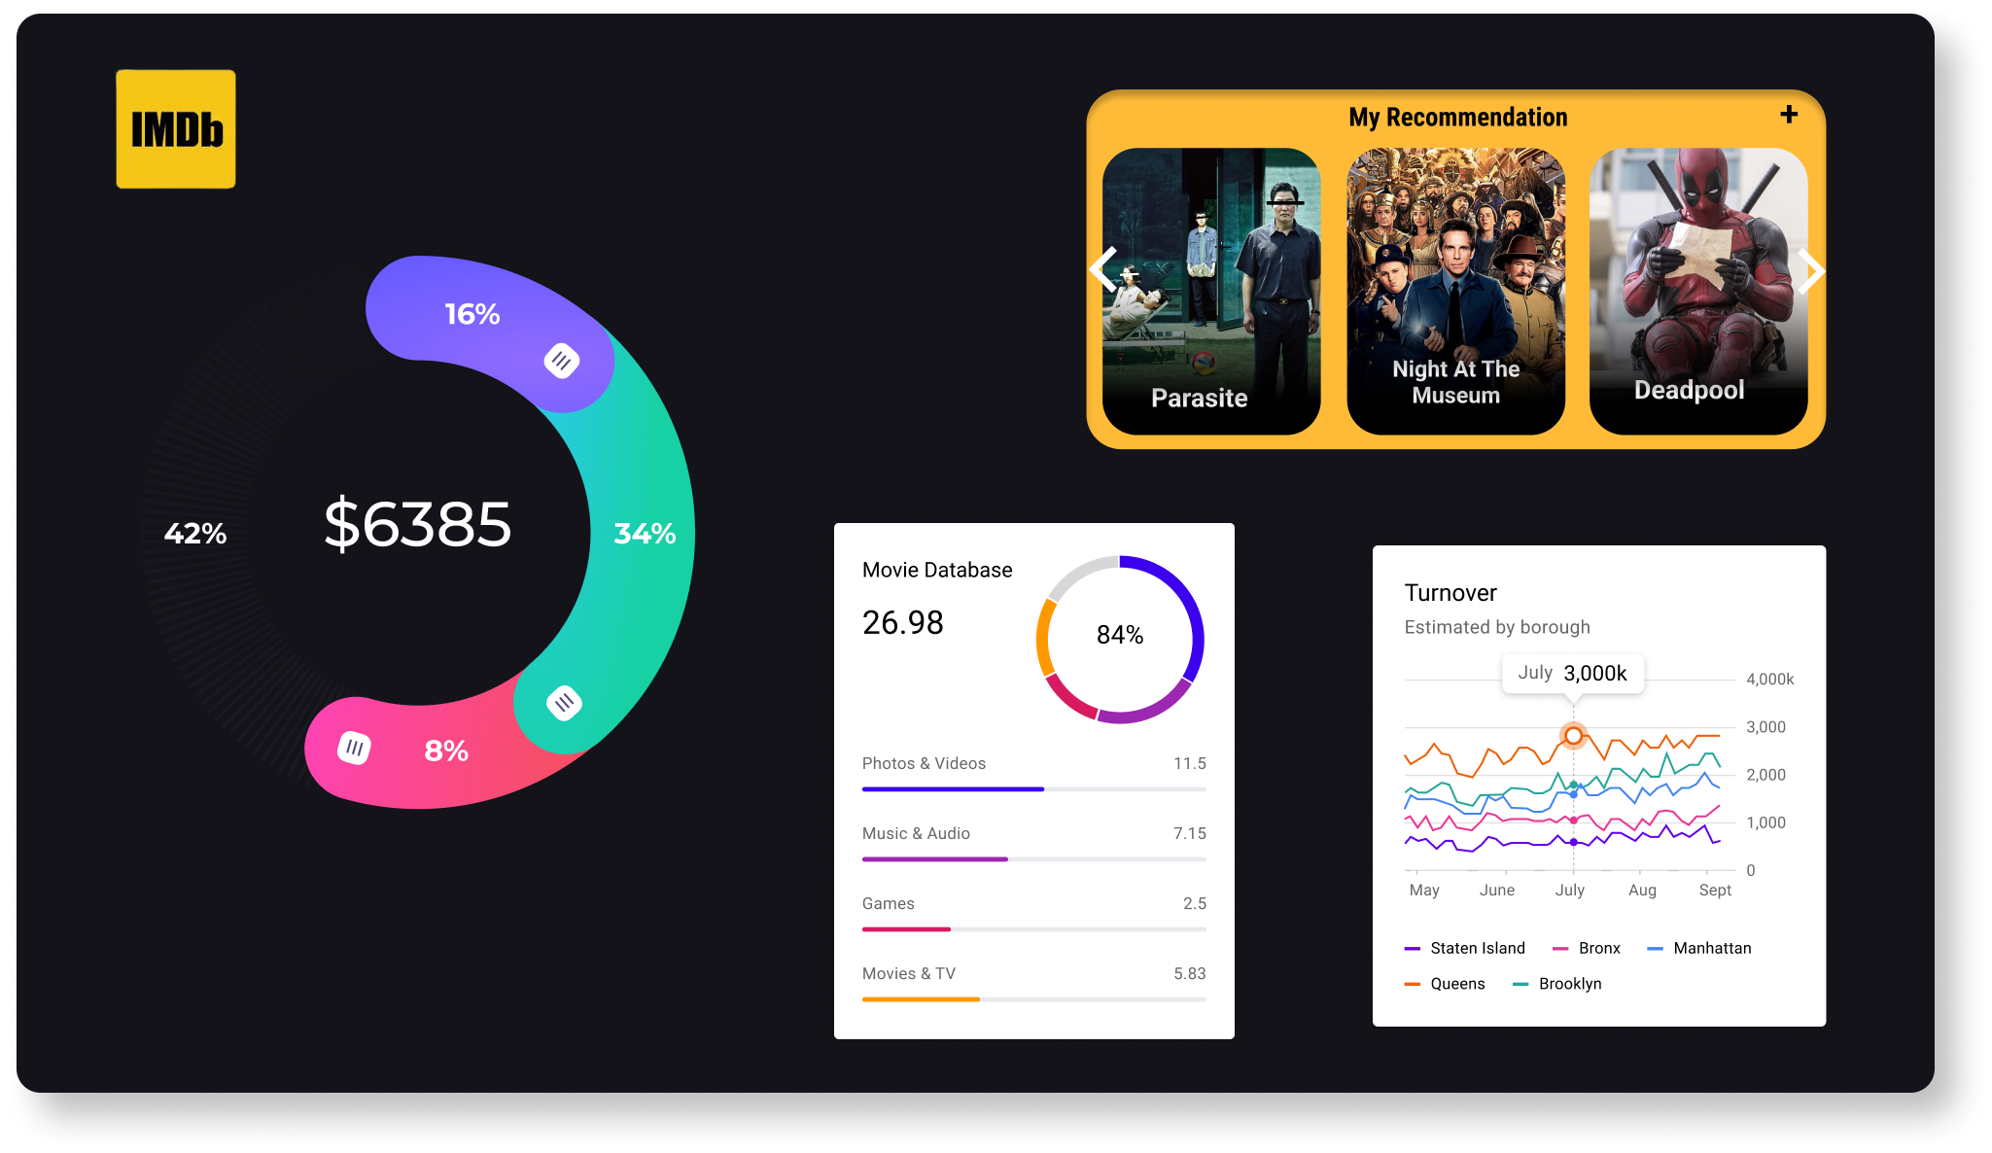
DESCRIPTION
IMDB means Internet Movie database. It is qiuet similar to Netflix where we get related information about movies, television shows, directors, biographies, plot summaries, reviews, video games and related information. Later it became a website and become a popular online platform where we can find information related to movies.

Slide 4
APPROACH:
Data set
Go through given dataset.
Data cleaning
Clean the given data set to provide results.
Functions and graphs
Use functions and graphs for better resuts.

Slide 5
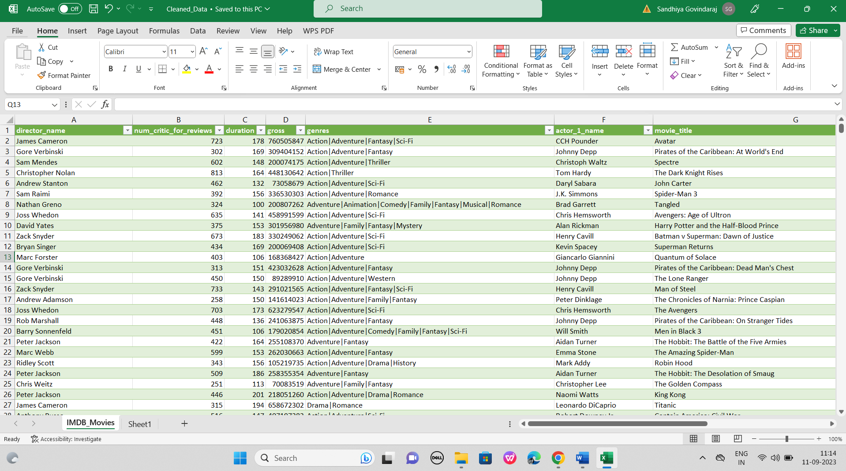
DATA CLEANING
This step involves preprocessing the data to make it suitable for analysis. It includes handling missing values, removing duplicates, converting data types if necessary, and possibly feature engineering.
I have moved with two process,
Step 1: Remove unwanted columns.
Step 2: Remove duplicates and null values.
Google drive link to view full worksheet:
https://drive.google.com/drive/folders/1dzv2ZfEeK-QxF_wzTnZ0WL9Wm6cLHx2R?usp=sharing

Slide 6
PROBLEM STATEMENT
The dataset provided is related to IMDB Movies. A potential problem to investigate could be: "What factors influence the success of a movie on IMDB?" Here, success can be defined by high IMDB ratings. The impact of this problem is significant for movie producers, directors, and investors who want to understand what makes a movie successful to make informed decisions in their future projects.

Slide 7

Tech-Stack Used
Microsoft-Excel

Slide 8
INSIGHTS:
1. Movie Genre Analysis
Select genre column from cleaned_data.
Separate genre column to provide comman genres report
After finding unique genre for each find mean, median, mode, range, variance and standard deviation with imdb_score column.
Functions used:
To count no.of movies use COUNTIF function.
Mean = AVERAGE (range,criteria)
Median = MEDIAN (range,criteria)
Mode = MODE (range,criteria)
Range = max-min
Variance = VAR (range,criteria)
Standard deviation = STDEV (range,criteria)

Slide 9
Results:
genres | no.of.movies | mean | median | mode | max | min | range | variance | Standard deviation
Action | 954 | 6.290671 | 6.3 | 6.1 | 9 | 2.1 | 6.9 | 1.069388 | 1.034112284
Adventure | 368 | 6.560326 | 6.7 | 7.3 | 8.6 | 2.3 | 6.3 | 1.258095 | 1.121648214
Animation | 45 | 6.74 | 7 | 7.1 | 8 | 4.5 | 3.5 | 0.942455 | 0.970800981
Biography | 206 | 7.160194 | 7.2 | 7 | 8.9 | 4.5 | 4.4 | 0.480944 | 0.693501516
Comedy | 995 | 6.169849 | 6.3 | 6.4 | 8.8 | 1.9 | 6.9 | 1.066052 | 1.032497839
Crime | 257 | 6.933852 | 7 | 7.4 | 9.3 | 3.3 | 6 | 0.767092 | 0.875837738
Documentary | 30 | 6.806667 | 7.4 | 7.5 | 8.5 | 1.6 | 6.9 | 2.723402 | 1.650273401
Drama | 675 | 6.826815 | 6.9 | 7.3 | 8.8 | 2.1 | 6.7 | 0.822559 | 0.906950291
Family | 3 | 6.5 | 5.9 | #N/A | 7.9 | 5.7 | 2.2 | 1.48 | 1.216552506
Fantasy | 37 | 6.281081 | 6.5 | 6.8 | 7.9 | 4.3 | 3.6 | 0.799354 | 0.894066191
Horror | 159 | 5.842138 | 5.9 | 5.9 | 8.5 | 2.3 | 6.2 | 1.059795 | 1.029463646
Musical | 2 | 6.75 | 6.75 | #N/A | 7.2 | 6.3 | 0.9 | 0.405 | 0.636396103
Mystery | 23 | 6.652174 | 6.7 | 7.1 | 8.5 | 3.3 | 5.2 | 1.193518 | 1.092482396
Romance | 2 | 6.65 | 6.65 | #N/A | 7.1 | 6.2 | 0.9 | 0.405 | 0.636396103
Sci-Fi | 8 | 6.5875 | 6.35 | #N/A | 8.2 | 5 | 3.2 | 1.064107 | 1.031555691
Thriller | 1 | 4.8 | 4.8 | 4.8 | 4.8 | 4.8 | 0 | 0 | 0
Western | 3 | 6.766667 | 7.3 | #N/A | 8.9 | 4.1 | 4.8 | 5.973333 | 2.444040371
Most comman genre is Comedy.

Slide 10
2. Movie Duration Analysis
Select duration column and imdb_score for analysis from cleaned_data
Find duration statistics with functions of mean, median and standard deviation.
Scatter plot to visualize the relationship between movie durations and imdb_score.
Use tredline for direction.
Function used:
Mean = AVERAGE (range, criteria)
Median = MEDIAN (range, criteria)
Standard Deviation = STDEV(range, criteria)

Slide 11
Results:
movie durations
mean | 110.2153
median | 106
Standard deviation | 22.72277

Slide 12
3. Language Analysis
Select language column for unique languages from cleaned_data
Calculate the statistics of mean, median and standard deviation for each languages.
Function used:
COUNTIF to count no.of movies for each languages.
Mean = AVERAGE (range, criteria)
Median = MEDIAN (range, criteria)
Standard Deviation = STDEV (range, criteria)

Slide 13
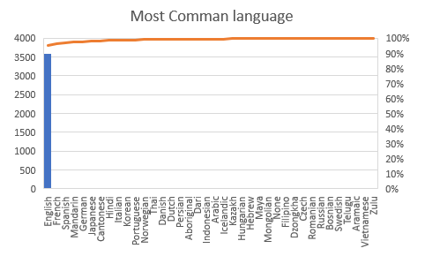
Results:
Unique languages | no.of.movies | mean | median | standard deviation
Aboriginal | 2 | 6.95 | 6.95 | 0.777817459
Arabic | 1 | 7.2 | 7.2 | 0
Aramaic | 1 | 7.1 | 7.1 | 0
Bosnian | 1 | 4.3 | 4.3 | 0
Cantonese | 8 | 7.2375 | 7.3 | 0.440575922
Czech | 1 | 7.4 | 7.4 | 0
Danish | 3 | 7.9 | 8.1 | 0.529150262
Dari | 2 | 7.5 | 7.5 | 0.141421356
Dutch | 3 | 7.566667 | 7.8 | 0.404145188
Dzongkha | 1 | 7.5 | 7.5 | 0
English | 3593 | 6.426273 | 6.5 | 1.049758669
Filipino | 1 | 6.7 | 6.7 | 0
French | 36 | 7.297222 | 7.25 | 0.565425812
German | 13 | 7.692308 | 7.7 | 0.640912811
Hebrew | 1 | 8 | 8 | 0
Hindi | 8 | 7.175 | 7.3 | 0.761108215
Hungarian | 1 | 7.1 | 7.1 | 0
Icelandic | 1 | 6.9 | 6.9 | 0
Indonesian | 2 | 7.9 | 7.9 | 0.424264069
Italian | 7 | 7.185714 | 7 | 1.155318962
Japanese | 12 | 7.625 | 7.8 | 0.899621132
Kazakh | 1 | 6 | 6 | 0
Korean | 5 | 7.7 | 7.7 | 0.570087713
Mandarin | 14 | 7.021429 | 7.25 | 0.765786244
Maya | 1 | 7.8 | 7.8 | 0
Mongolian | 1 | 7.3 | 7.3 | 0
None | 1 | 8.5 | 8.5 | 0
Norwegian | 4 | 7.15 | 7.3 | 0.574456265
Persian | 3 | 8.133333 | 8.4 | 0.550757055
Portuguese | 5 | 7.76 | 8 | 0.978774744
Romanian | 1 | 7.9 | 7.9 | 0
Russian | 1 | 6.5 | 6.5 | 0
Spanish | 23 | 7.082609 | 7.2 | 0.860577065
Swedish | 1 | 7.6 | 7.6 | 0
Telugu | 1 | 8.4 | 8.4 | 0
Thai | 3 | 6.633333 | 6.6 | 0.450924975
Vietnamese | 1 | 7.4 | 7.4 | 0
Zulu | 1 | 7.3 | 7.3 | 0
Most Comman Language is English.

Slide 14
4. Director Analysis
Select director column and imdb_score column from cleaned_data.
Separate unique directors and find each average score with imdb_score using AVERAGE(range,criteria) function.
Find percentile for each unique directors with PERCENTRANK.EXC function.
Select top directors with highest average score and compare with overall distribution of scores.

Slide 15
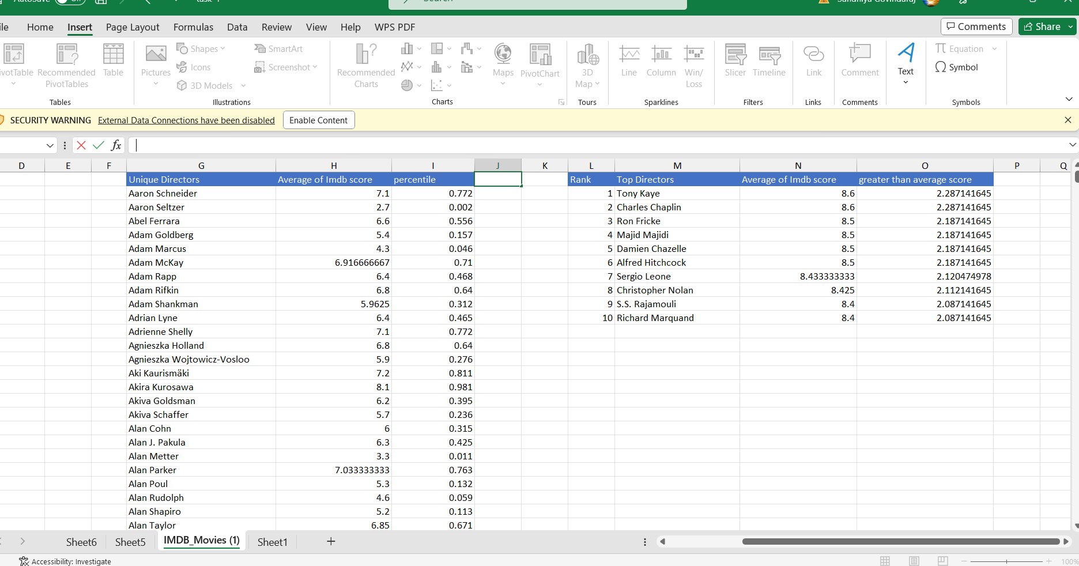
Results:

Slide 16
5. Budget Analysis:
Select budget and gross column to find profit. Difference between gross and budget is the result of profit.
Find correlation between budget and profit
Select top movies with highest profit
Find highest profit margin using MAX(range) function.

Slide 17
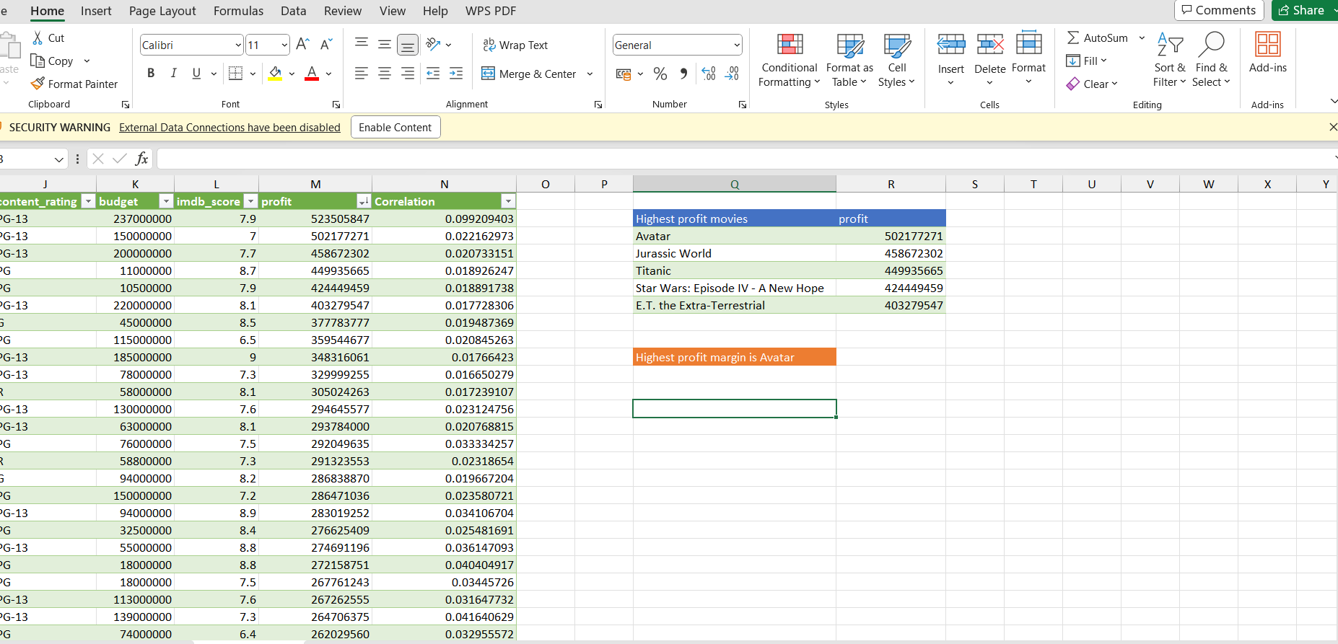
Results:
Highest profit movie is Avatar.
Highest profit movies | profit
Avatar | 502177271
Jurassic World | 458672302
Titanic | 449935665
Star Wars: Episode IV - A New Hope | 424449459
E.T. the Extra-Terrestrial | 403279547

Slide 18
Google drive link for excel sheets:
https://drive.google.com/drive/folders/1dzv2ZfEeK-QxF_wzTnZ0WL9Wm6cLHx2R?usp=sharing

Slide 19
Thank you

